Slide 1
Grid Network Experiments 1
Feng Yuzhen
2021/8/11

Slide 2
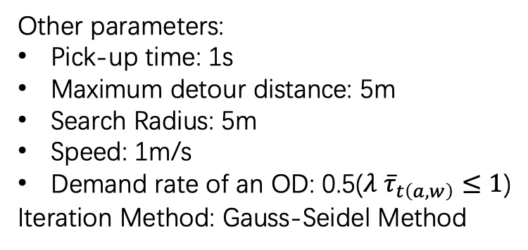
Time Consumed of Each Step
Network | OD | Taker | Match | Iteration | Step 0 / s | Step 1 / s
30*30 | 300 | 5056 | 32772 | 29 | 0.488 | 0.453
180*180 | 2000 | 191956 | 148530 | 20 | 108.342 | 4.285
180*180 | 1e4 | 9.5e5 | 3.6e6 | 25 | 2692.946 | 53.341
Other parameters:
Pick-up time: 1s
Maximum detour distance: 5m
Search Radius: 5m
Speed: 1m/s
Demand rate of an OD: 0.5($λ {\overline{τ}}_{t\left(a,w\right)}≤1$)
Iteration Method: Gauss-Seidel Method

Slide 4
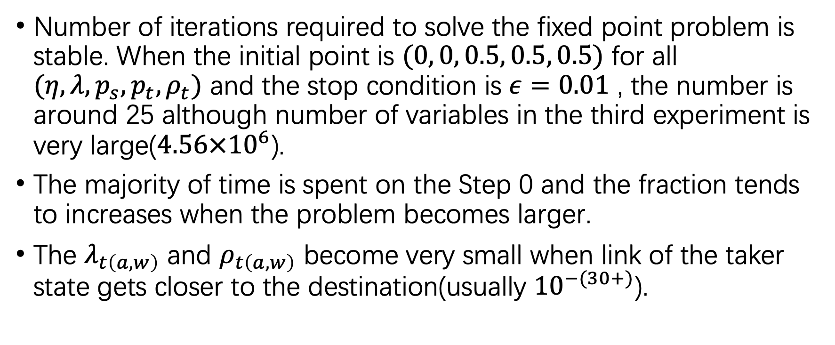
Phenomenon
Number of iterations required to solve the fixed point problem is stable. When the initial point is $(0, 0, 0.5, 0.5, 0.5)$ for all $(η, λ, p_{s}, p_{t}, ρ_{t})$ and the stop condition is $ε=0.01$ , the number is around 25 although number of variables in the third experiment is very large($4.56×{10}^{6}$).
The majority of time is spent on the Step 0 and the fraction tends to increases when the problem becomes larger.
The $λ_{t\left(a,w\right)}$ and $ρ_{t\left(a,w\right)}$ become very small when link of the taker state gets closer to the destination(usually ${10}^{−(30+)}$).

Slide 5
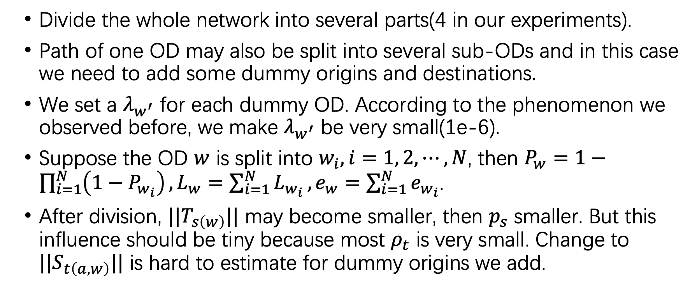
Divide and Combine
Divide the whole network into several parts(4 in our experiments).
Path of one OD may also be split into several sub-ODs and in this case we need to add some dummy origins and destinations.
We set a $λ_{w^{′}}$ for each dummy OD. According to the phenomenon we observed before, we make $λ_{w^{′}}$ be very small(1e-6).
Suppose the OD $w$ is split into $w_{i}, i=1, 2, ⋯, N$, then $P_{w}=1−\prod_{i=1}^{N}{\left(1−P_{w_{i}}\right)},L_{w}=\sum_{i=1}^{N}{L_{w_{i}}}, e_{w}=\sum_{i=1}^{N}{e_{w_{i}}}$.
After division, $||T_{s\left(w\right)}||$ may become smaller, then $p_{s}$ smaller. But this influence should be tiny because most $ρ_{t}$ is very small. Change to $||S_{t\left(a,w\right)}||$ is hard to estimate for dummy origins we add.

Slide 7
Phenomenon
Time of Step 0: 67.296 s
Time of Step 1: 6.533 s
Number of ALL iterations: 74
Number of variables:
Sub-network | OD | Taker | Match | Iteration
1 | 1059 | 52118 | 137129 | 19
2 | 980 | 46267 | 132703 | 19
3 | 1013 | 48968 | 129157 | 18
4 | 986 | 46641 | 120638 | 18
Total | 4038 | 193994 | 519627 | 74

Slide 9
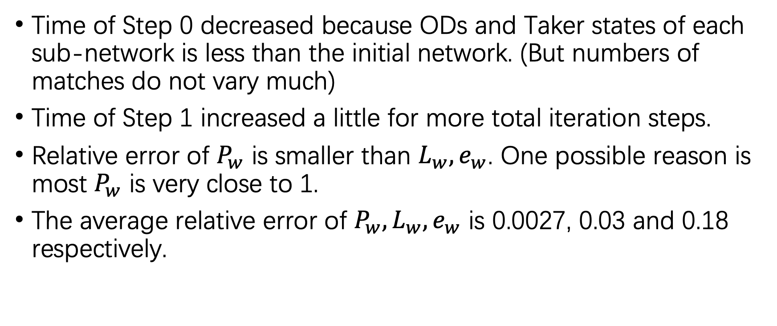
Phenomenon
Time of Step 0 decreased because ODs and Taker states of each sub-network is less than the initial network. (But numbers of matches do not vary much)
Time of Step 1 increased a little for more total iteration steps.
Relative error of $P_{w}$ is smaller than $L_{w}, e_{w}$. One possible reason is most $P_{w}$ is very close to 1.
The average relative error of $P_{w}, L_{w}, e_{w}$ is 0.0027, 0.03 and 0.18 respectively.

Slide 10

Phenomenon
OD that has the most relative error is close to boundary of sub-networks.
By changing the initial $λ_{w^{′}}$ of these sub-ODs, the value of $e_{w^{′}}$ will become close to the right value.

Slide 11
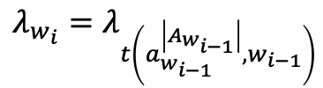
$$λ_{w_{i}}=λ_{t\left(a_{w_{i−1}}^{\left|A_{w_{i−1}}\right|},w_{i−1}\right)}$$

Slide 12

Result Analysis
After adjusting $λ_{w}$ the first iteration will converge very quickly(mostly one time only).
According to Yang Shan's experimental conclusion, the fixed point is stable.
 |  | Pw | Lw | ew
Average relative error | Only one iteration | 0.00278172 | 0.0319647 | 0.18177789
 | Two iterations | 0.00275403 | 0.03311858 | 0.15412118
Maximum relative error | Only one iteration | 0.26552801 | 0.22858136 | 0.96446668
 | Two iterations | 0.26576734 | 0.22560803 | 0.78381257

Slide 13
23 iterations, 35.287s
(include one iteration that exceeds maximum number 200)

